Slide 1

Trail Funding Strategies
UMVRDC | January 2026

Slide 2
Why Funding Strategy Matters
Trail projects often take multiple years
Each funding source has different approval processes and cash flow timing
Understanding timelines helps avoid stalled projects

Slide 3
Key Questions Before Applying
Is this planning, construction, or maintenance?
Is the project transportation or recreation focused?
Do you need funding soon or can you wait 2–5 years?
Do you have local cash match available?

Slide 4
Choosing the Right Program
Federal versus State Funding
Match Requirements
Competitiveness: Recreation funding versus Transportation funding

Slide 5
Layering Funding Over Time
Planning grant → construction grant
Apply to multiple programs
Stack funding, based on when funding becomes available:
How to cover match requirements

Slide 6
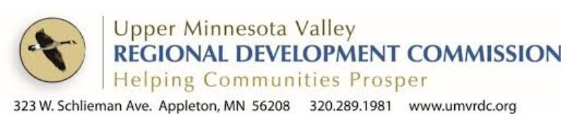
Questions to Consider & Next Steps
What kind of trail project are you considering?
Timeline goals?
Funding readiness?
The UMVRDC can help!

Slide 7
Transportation Alternatives Program (TAP)
What it funds: Paved trails (reconstruction or new), ADA upgrades, active transportation connections
Typical Award: $200,000+
Match: 20% local (cash or eligible funds)
Timeline: Application annual, awarded in 2-3 months, construction 5 years (typically)
Example: Appleton Trail Reconstruction

Slide 8
Carbon Reduction Program (CRP)
What it funds: Projects that reduce transportation-related emissions
Typical Award: $200,000+
Match: 20% local (cash or eligible funds)
Timeline: Application annual, awarded in 2-3 months, construction 5 years (typically)
Example: Breckenridge Border States Trail

Slide 9
Federal Recreational Trail Program
Award Range: Trail projects $2,500 – $200,000; equipment up to $75,000
Match: 25% cash or in-kind
Timeline: Application due Feb; awards summer
Best for: Maintenance, rehabilitation, trailheads, amenities, paved trails (reconstruction or new), ADA upgrades

Slide 10
Regional Trail Grant Program (DNR)
Award Range: $5,000 – $300,000
Match: 25% non-state cash, reimbursement-based
Timeline: Application due March; awards summer after; funds available late that year; project completion 2–3 years
Best for: Regionally significant trails

Slide 11
Active Transportation Program (AT)
What it funds: Paved trails (reconstruction or new), ADA upgrades, active transportation connections
Typical Award: $50,000+
Match: No Match
Timeline: Application annual, awards announced approximately 4–6 months after application deadline, construction typically begins the following construction season (about 1 year after award depending on project readiness).
Example: Graceville-Beardsley Schools

Slide 12
Local Trail Connections Program (DNR)
Award Range: $5,000 – $250,000
Match: 25% non-state cash
Timeline: Final application March; awards the same summer; funds late the year of application
Best for: Short trail links, neighborhood connections, equity-focused projects

Slide 13
LCCMR (Legislative-Citizen Commission on MN Resources)
What it is: Legislative funding process using lottery proceeds
Typical Award: $500,000 – several million
Match: Not always required, partnerships important
Timeline: Concept proposal → 1 year; full proposal → additional year; legislative approval → funding following fiscal year (~2–3 years total)
Example: Appleton Trail

Slide 14
Safe Routes to School (SRTS)
Award Size: Varies by project type
Match: No Match
Timeline: 1-2 years, typically
Best for: School-area trail connections, sidewalks, crossings
Example: Graceville-Beardsley Schools

Slide 15
Contact Information
W: 320.289.1981 x113
C: 276.733.3362
savannah@umvrdc.org
323 West Schlieman Ave. Appleton, MN 56208

