Slide 1
OPEN HOUSE to seek public comment on the draft List of Federally Funded TRANSPORTATION Projects
March 19, 2024

Slide 2
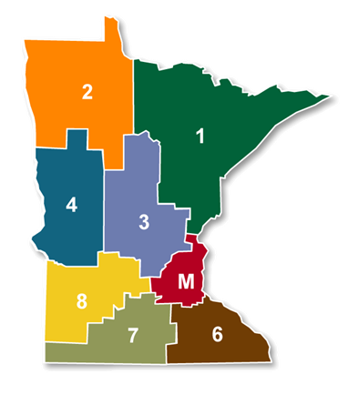
Why are we here?
The public is encouraged to provide comment on projects that are identified in the Area Transportation Improvement Program (or ATIP) and suggest projects for future consideration
The projects identified on this list are the 2025-2028 projects that MnDOT will request federal transportation funding for
The current list is a draft project list and can be influenced by public opinion
MnDOT District 4 will cover the project list for
projects located within Big Stone and Swift Counties
MnDOT District 8 will cover the project list for
projects located within Chippewa, Lac qui Parle,
and Yellow Medicine Counties

Slide 3
What projects?
Roads
Bridges
Public Transit
Rail Safety
Safety Improvements
Transportation Alternatives
Safe Routes to School Projects
Bike and pedestrian facilities

Slide 4
How does the process work?

Slide 5
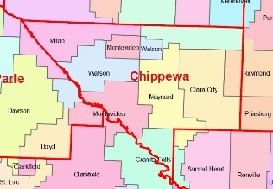
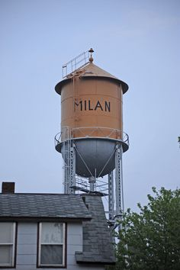
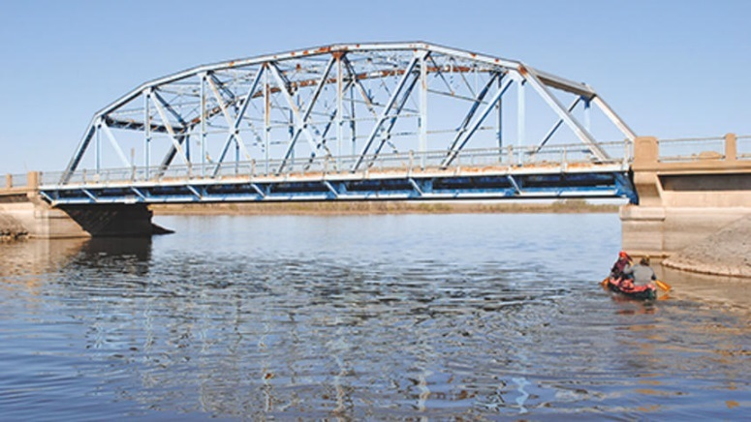
Process begins locally
Engineer or public identify needed improvement
Local road authority is determined

Slide 6
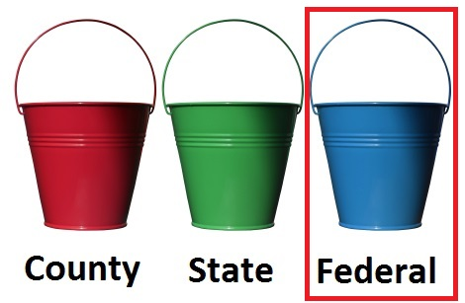
Process begins locally
Funding options for project are identified
If project is eligible and identified for federal funding by the county, project is submitted to the ATP

Slide 7
Next steps are to the ATP
Projects are vetted by the ATP subcommittee
Projects are recommended to full ATP

Slide 8
Who makes the decisions?
Federal Highway Administration
Minnesota Department of Transportation
Area Transportation Partnerships
Allocates funding from the federal transportation bill to states
Allocates federal funding to the ATPs
Seeks input from the public about proposed projects
Determines rules and eligibility for projects
Implements rules and program areas
Recommends list of projects to State
Allocates funding to eligible project areas
Solicits projects
Approves project list from ATPs across the State and recommends list to FHWA
Designates a board of transportation stakeholders to act as ATP
Final approval of all projects from states

Slide 9
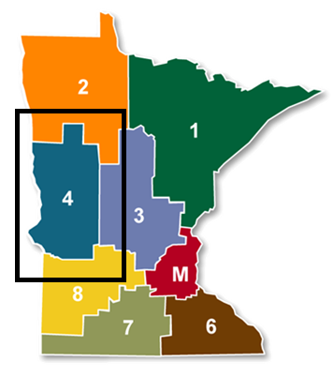
Who serves on the ATP?
West Central Minnesota Area Transportation Partnership (ATP 4)
RDC 4: West Central Initiative |  | RDC 2: Headwaters RDC
Ken Johnson, County Commissioner |  | Jonathon Large, County Engineer
Bob Kopitzke, County Commissioner
Brian Giese, County Engineer |  | Metropolitan planning representative
Chad Gillespie, County Engineer |  | Dan Farnsworth, FM COG
RDC 6W: Upper Minnesota Valley RDC |  | MnDOT Representatives
Harold “Rusty” Dimberg, Big Stone County |  | Shiloh Wahl, District Engineer
 |  | Tom Lundberg, Assistant District Engineer
State Aid City Representative |  | Nathan Gannon, State Aid Engineer
Jeff Kuhn, City of Morris |  | John Groothis, MnDOT Transit Manager Mary Safgren, MnDOT Planning Director Rosemary Bruce-White, MnDOT Principal Planner Ben Griffith, FM COG
Tribal representative |  | Transit Representative
Michael Bowman, Sr, White Earth Public Works |  | Kayla Sullivan, Transit Director
 |  | FHWA representative
*Chair **Vice-Chair |  | Kris Riesenberg, Technical Services Team Leader
ATP Technical Advisors
West Central Initiative (RDC 4)
Wayne Hurley
Upper Minnesota Valley RDC (RDC 6W)
Brianne Nelsen
Headwaters RDC (RDC 2) Tony Klaers
ATP 4 (Big Stone, Swift, Pope, Stevens, Douglas, Grant, Traverse, Wilkin, Ottertail, Becker, Clay and Mahnomen Counties)

Slide 10
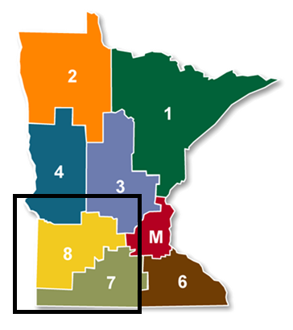
Who serves on the ATP?
ATP 8 (Chippewa, Lac qui Parle, Yellow Medicine, Renville, Meeker, McLeod, Kandiyohi, Redwood, Lincoln, Lyon, Murray and Pipestone Counties)
Southwest Area Transportation Partnership (ATP 8)
RDC 6E: Mid-Minnesota Development Commission | RDC 8: Southwest Regional Development Commission
Doug Krueger, McLeod County Commissioner | Mic VanDerVere, Lincoln County Commissioner
Doug Erickson, Renville County Commissioner | Bob Byrnes, City of Marshall Mayor *
Jeff Marlowe, Renville County Engineer | Joe Wilson, Lincoln County Engineer
RDC 6W: Upper Minnesota Valley RDC | MnDOT Representatives
Bill Pauling, Chippewa County Commissioner ** | Jon Huseby, D8 Mn/DOT District Engineer
John Berends, Yellow Medicine County Commissioner | Todd Broadwell, Assistant District Engineer
Sam Muntean, Lac qui Parle County Engineer | Susann Karnowski, Program and Project Development Mgr. Megan DeShepper, Planning Director Tracy Schnell, Principal Planner
State Aid City Representative | Transit Representative
Justin Black, City of Hutchinson | Nick Leske, UCAP
*Chair **Vice-Chair
ATP Technical Advisors
Southwest RDC (RDC 8)
Chris Webb
Upper Minnesota Valley RDC (RDC 6W)
Brianne Nelsen
Mid-Minnesota Development Commission (RDC 6E)
Mike NIcholas

Slide 11
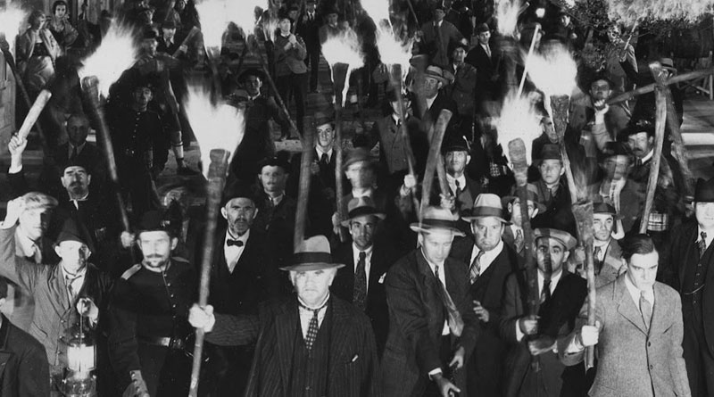
ATP Engages with the public
ATP seeks public input (today)
The process is then guided by the input received

Slide 12
Overview of the whole process
County engineer or public identify needed improvement
Local road authority is determined
Funding options for project are identified
If project is eligible and identified for federal funding by the county, project is submitted to the ATP
Projects are vetted by the ATP subcommittee
Projects are recommended to full ATP
ATP seeks public input (today)
The process is then guided by the input received

Slide 13
What happens next?
April - ATPs meet to review public comments, make revisions if needed, and approve the ATIP to submit to MnDOT Central Office
July - STIP approval by MnDOT Commissioner
August - STIP is submitted to the Federal Highway Administration (FHWA)
Fall - final STIP approval by FHWA

Slide 14
Your role
You can submit a comment by completing the form online at the UMVRDC website. All comments made at today’s meeting will be forwarded to MnDOT and the ATP for review and consideration.
Online information can be found at https://umvrdc.org/program/transportation/

Slide 15
Thank You!
For further questions, comments, or suggestions, please contact:
Brianne Nelsen
searle@umvrdc.org
320-289-1981 ext. 113
UMVRDC
323 Schlieman Ave
Appleton, MN 56208

