Slide 1
Minnesota Intelligent Rural Communities
Place Photo Here,
Otherwise Delete Box
MIRC

Slide 2
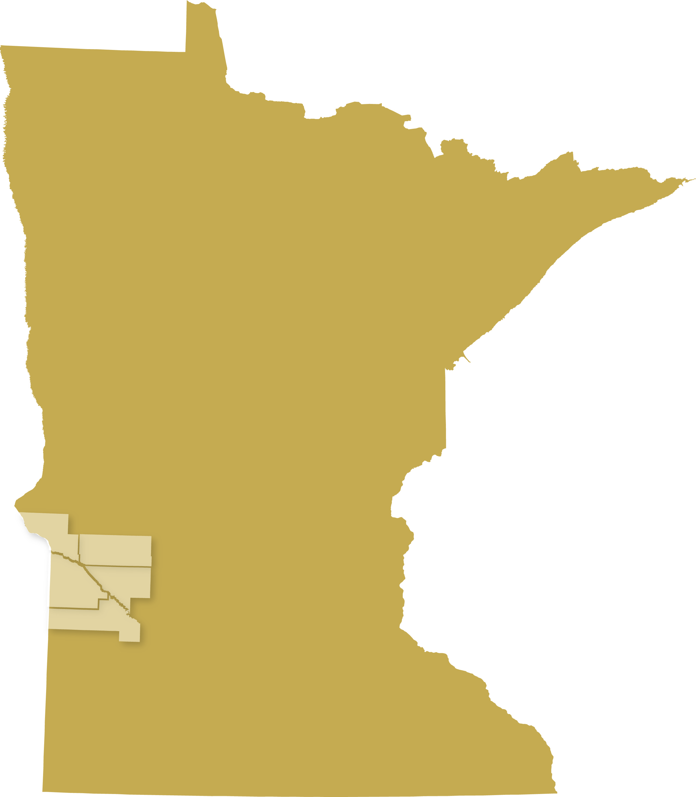
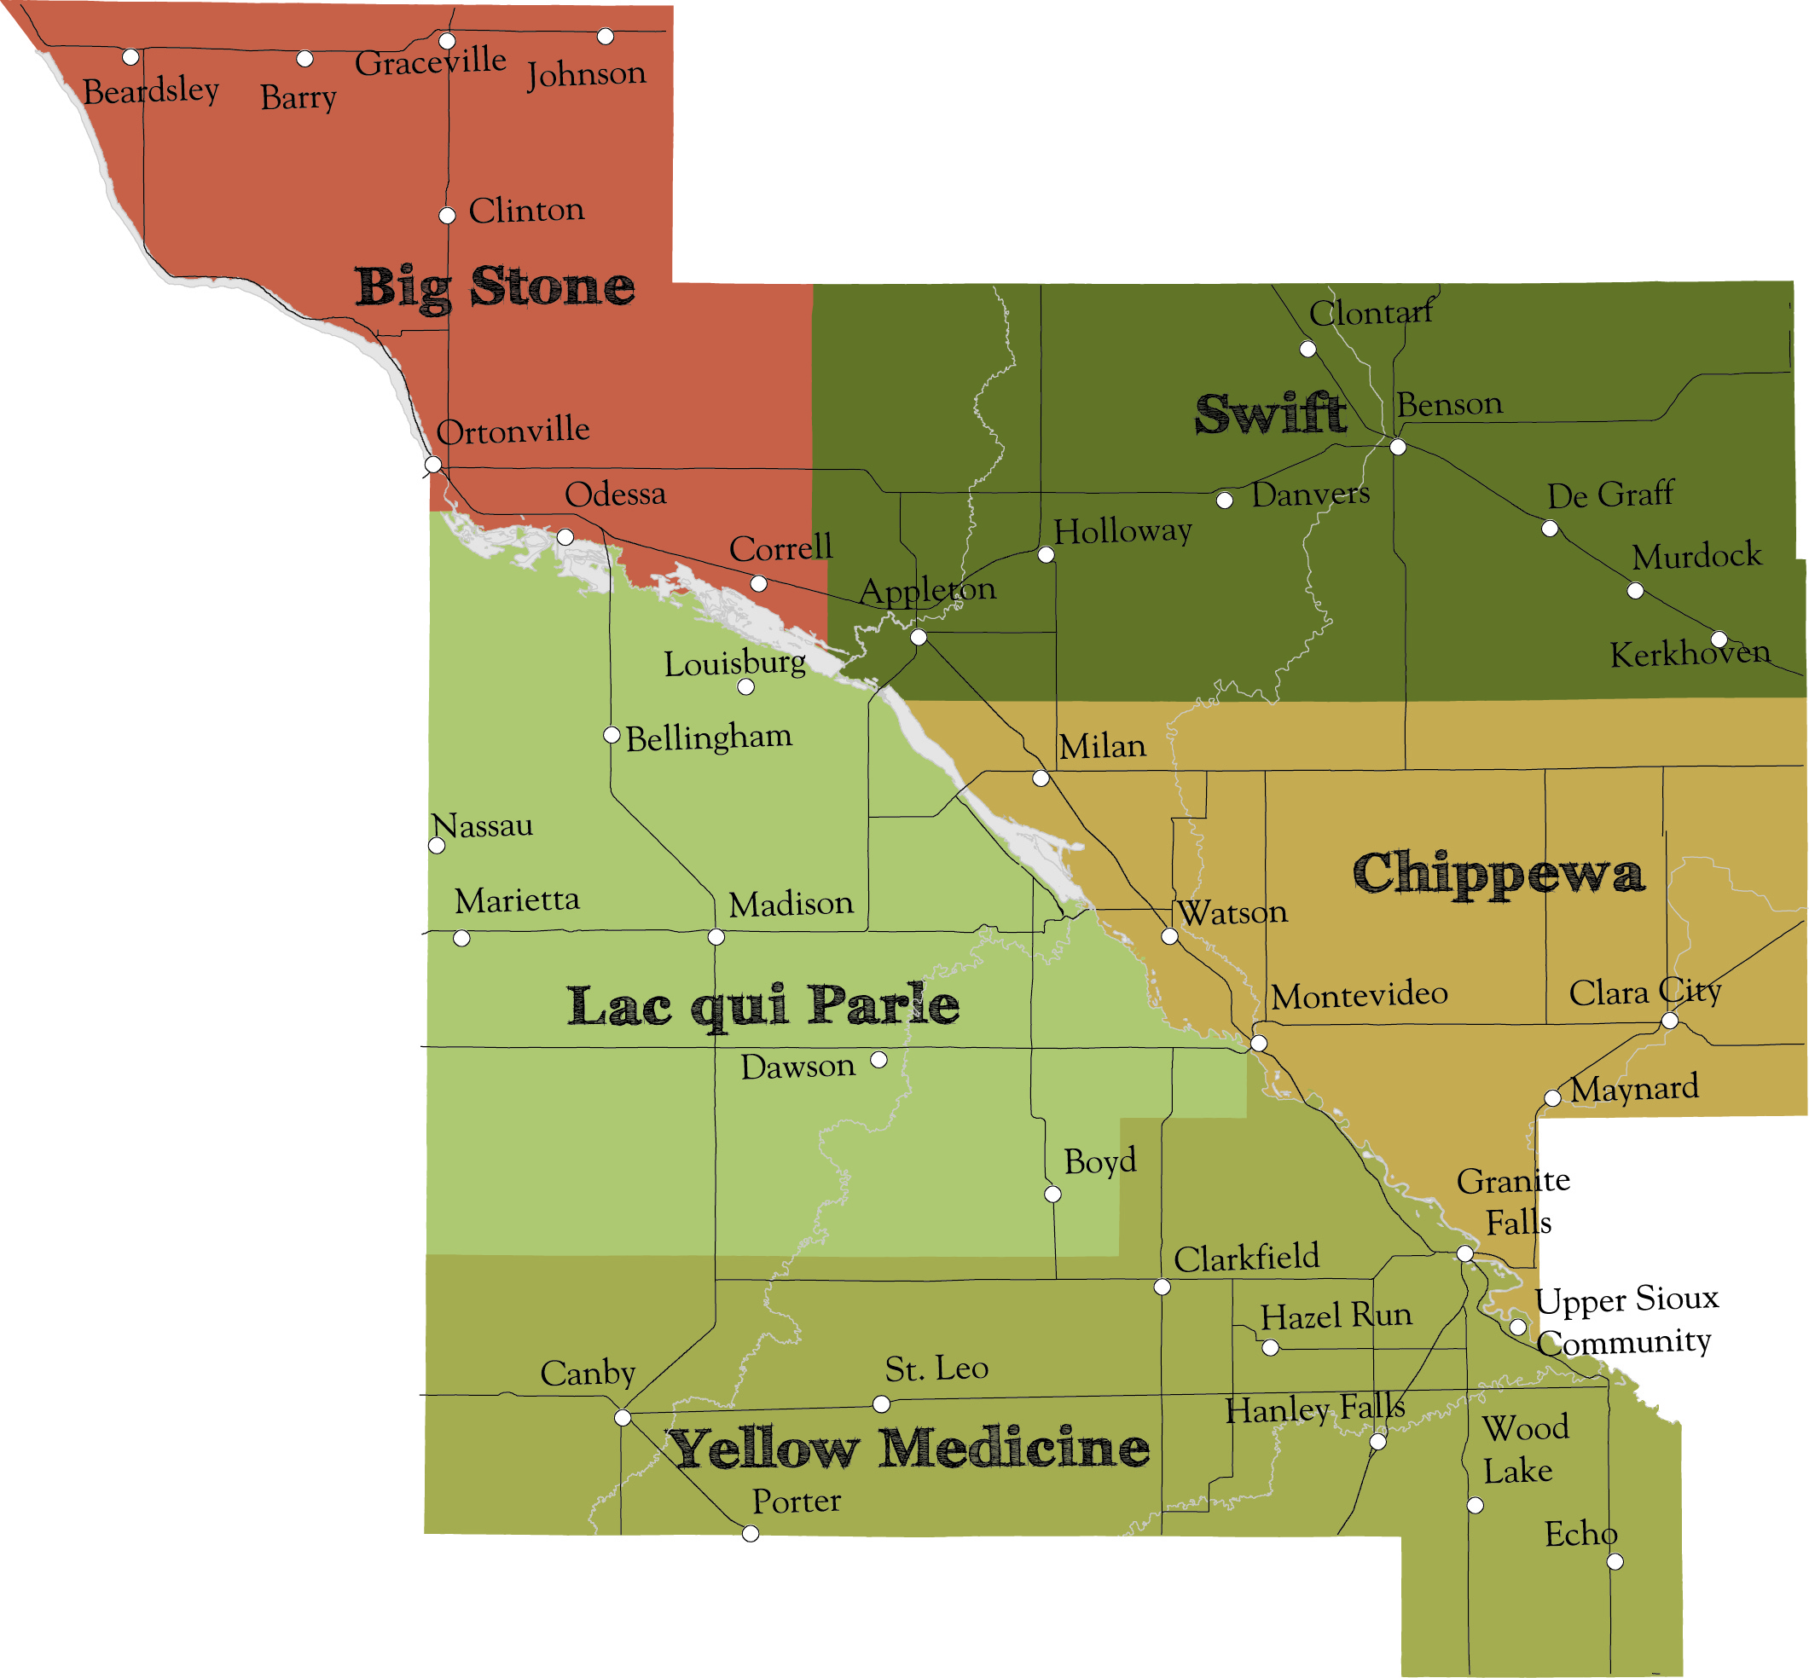
UMVRDC Region
5 Counties
37 Cities 94 Townships
10 School Districts 1 Tribal Community
• 70% of cities have populations under 500
• 67.5% Computer Ownership in the region
• Compared with 74.3% in rural MN statewide
• Broadband adoption rate in the region Is 57.6%
• Compared with 64% in rural MN statewide
Big Stone, Chippewa, Lac qui Parle, Swift & Yellow Medicine
Increase the number of broadband subscribers
Increase the culture of use of broadband-based services
Increased efficiency and effectiveness of digital literacy training service delivery
Increased economic vitality in rural Minnesota communities

Slide 3
7 Projects • $90,000 • $137,000
Marketing/ Advocacy
Digital Inclusion
Innovation
Pioneer Public TV
Lac qui Parle County Computer Commuter
Dawson Boyd Schools MCC
Echo & Bellingham
Who/Where?
Johnson Memorial
Home Health
Knowledge Workforce
Ortonville
EDA & Schools
Everyone Online
Big Stone County GIS

Slide 4
Pioneer Public TV
Farming
Producing video content for broadcast and/or web use describing the challenges facing rural area in the availability and use of broadband
Youth
Business
Newcomers

Slide 5
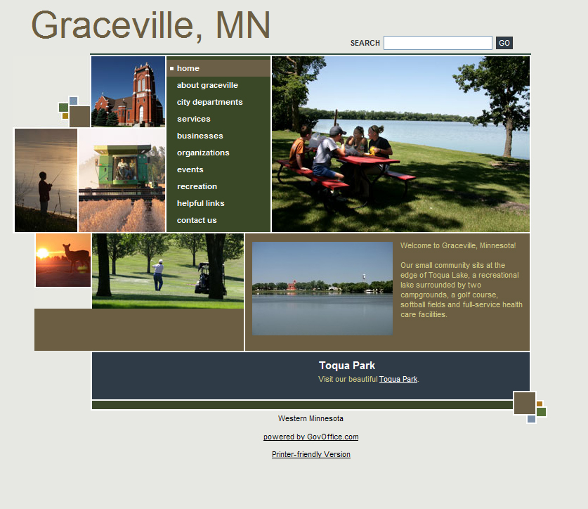
Bellingham / Echo Websites
Bellingham
Population: 168
0.4 square miles
Median age: 48 years
Median household income: $27,083
Echo
Population: 278
1.0 square mile
Median age: 40 years
Median household income: $27,656
19 of 37 cities do not have websites.

Slide 6
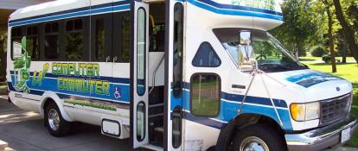
Lac qui Parle County Computer Commuter
Increasing Digital Literacy – Traveling 5 days a week to 6 different communities – Twelve local partners making this project happen – Offering 1 on 1 assistance

Slide 7
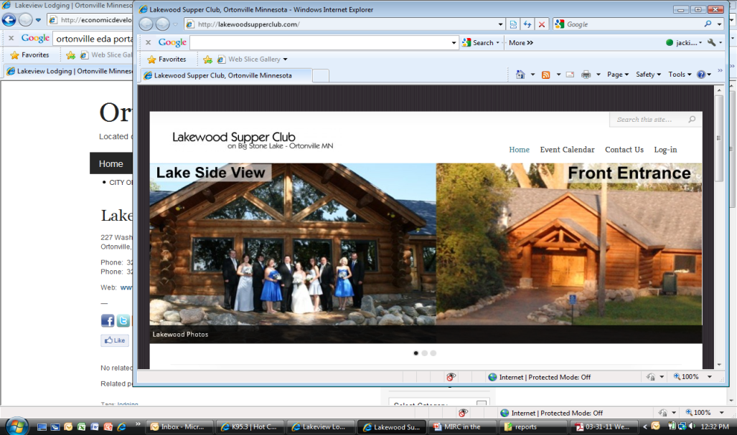
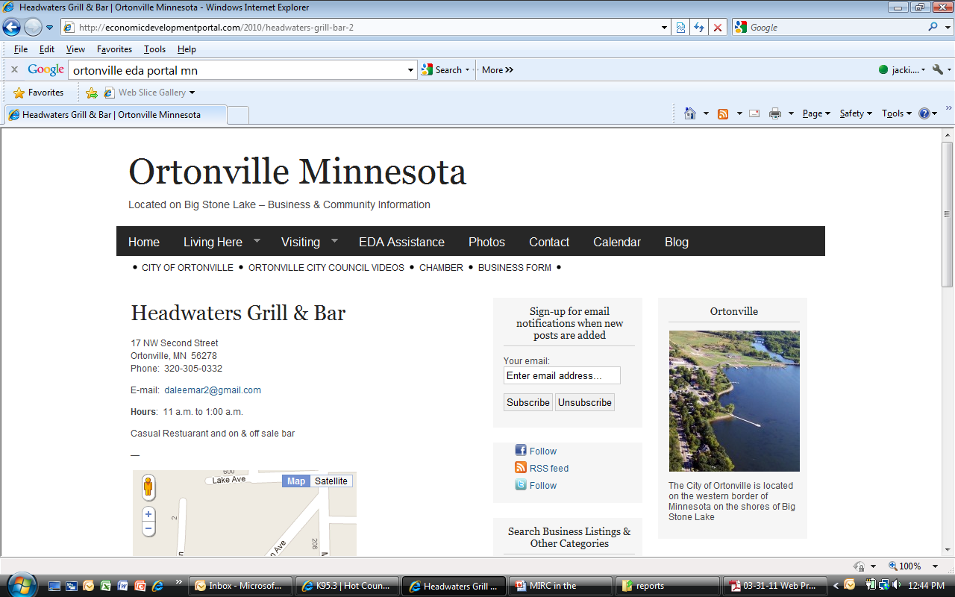
Ortonville School / EDA Project
Goal: For every business in Ortonville
to have a web presence!
Lakewoodsupperclub.com
Economicdevelopmentportal.com

Slide 8
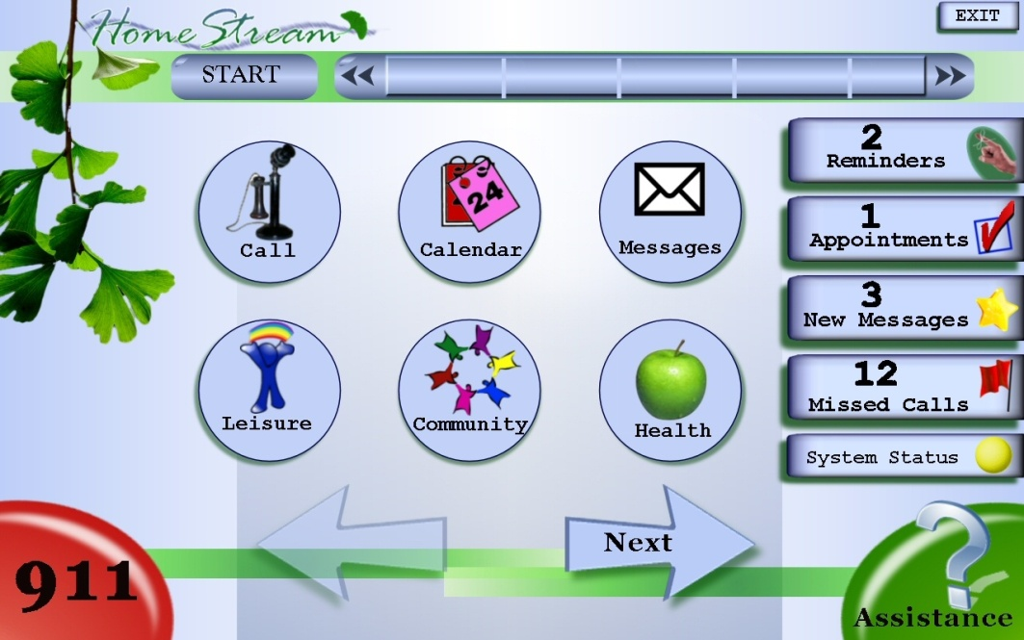
Johnson Memorial Home Health Project
Staying Home Longer
Using broadband-based remote support tools and enhanced family engagement to reduce hospital readmissions and to achieve increased medication adherence for better health outcomes.
Enhancing Family Connections
Keeping Health Records Organized

Slide 9
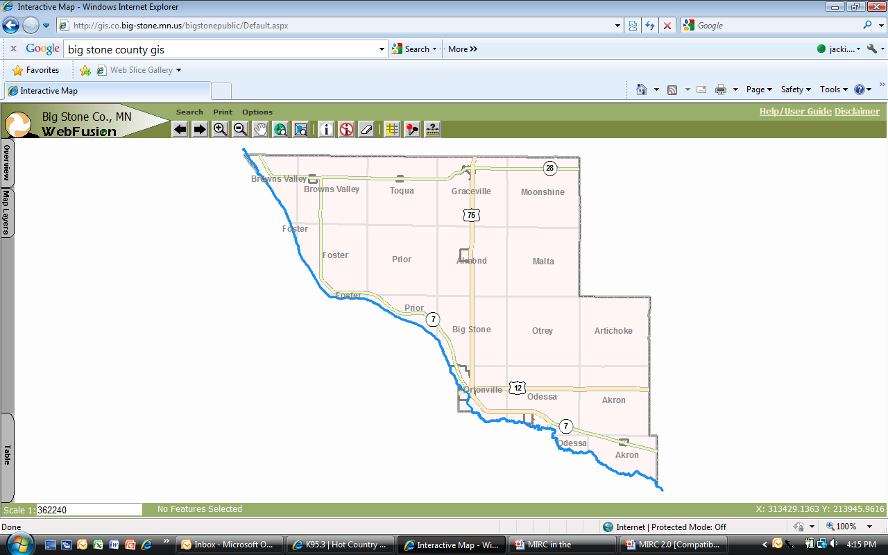
Big Stone County GIS Project
Added a public GIS computer in the Environmental Office
Updated computers in the Recorder & Assessor Offices
All offices are able to teach the public how to use these systems
“It is important to provide access to information they need regardless of our office hours, especially to real estate businesses and banks that could be working on a purchase or sale where time is critical.”
Big Stone County IT Coordinator

Slide 10
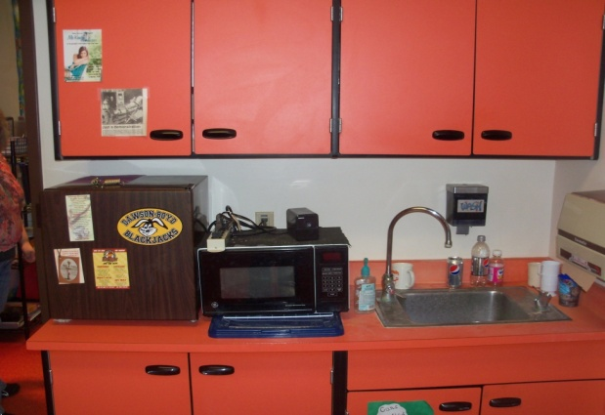
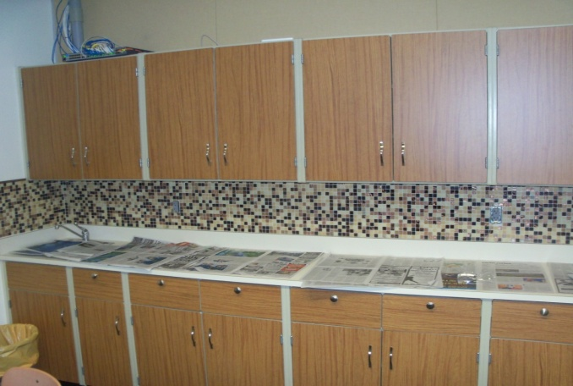
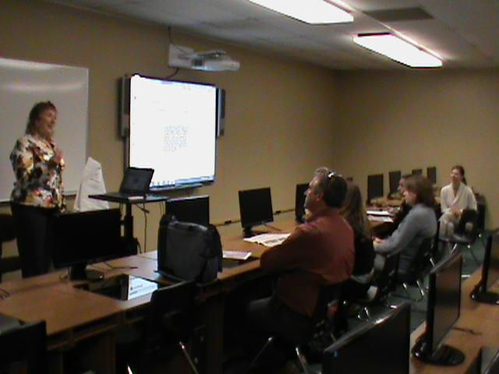
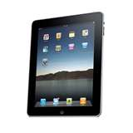
Dawson / Boyd Schools Multi-Collaboration Center
A hybrid online classroom
Teacher / Community Training Academy
Student Tech Team
Computer Savvy Specialist
Raising the bar!

Slide 11
University of MN Extension
Helping businesses learn how to be visible on the Internet!
Fall Line-up Community
Blogging for Business Ortonville Financial Transactions On-line Montevideo
Google Tools Granite Falls
Marketing Your Website Canby
Roadside Advertising in a Digital Age Clara City
Websites Simple to Complex Appleton
Mobile e-Marketing Dawson
Using Social Media in Business Benson

Slide 12
Project Impact
Demonstration Project
Extension Classes
Knowledge Worker Courses
Steering Committee & Partners

Slide 13
Project Impact
Demonstration Projects
Project Insights
Extension Classes
Best Practices
Get the right people on board
Be prepared to explain how a new program or opportunity can fit into existing programs
Clearly identify expectations from steering committee and project recipients
Leverage, Leverage, Leverage!
On-going Challenges
Infrastructure & Geography
Knowledge Gaps
What does “better” broadband mean?
Planning & Knowing the Options
Business
Government
Individuals
On-going Communication
Knowledge Worker Courses
Steering Committee & Engaged Individuals

Slide 14
THANK YOU!
Jacki Anderson
Senior Planner
jacki.anderson@umvrdc.org
www.umvrdc.org

